Slide 1
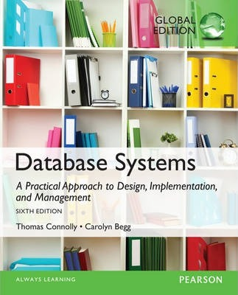
End-semester Review Part 1
Ali Chelli
Course: Database 2 (DAT2000R)

Slide 2
Exam Structure
Lecture No.
Lecture 1 - Introduction
Lecture 2-1: Database Architecture Lecture 2-2: Physical Storage and Indexes
Lecture 3: Database Administration and Security
Lecture 4: Stored Procedures
Lecture 5: Triggers
Lecture 6: Transaction Management
Lecture 7: Backup and Recovery
Lecture 8: Query Optimization and Denormalization
Lecture 9: Object-Oriented Databases and User-Defined Data Types
Lecture 10: XML and JSON
Lecture 11: Big Data and NoSQL
Q1: Lecture Specific (20 points)
Q2: Lecture Specific (15 points)
Q3: Lecture Specific (20 points)
Q4: Lecture Specific (15 points)
Q5: Lecture Specific (15 points)
Q6: Lecture Specific (15 points)

Slide 3
DBMS Basics
Why do we need a database System? → To store and retrieve data
A database is a collection of your data stored in a computer
A DBMS (Database Management System) is a software that manages databases
It answers queries fast
It recovers from crash
Queries (from multiple users) can execute concurrently without affecting each other

Slide 4
Database Architecture

Slide 5

File-Based Systems: Data Management Before Databases
Collection of application programs that perform services for the end users (e.g., reports).
Each program defines and manages its own data.
Data
123
Tina
CR76
Files
Application programs
Department X
Data
123
Tina
CR76
Files
Application programs
Department Y
File-based system

Slide 6
Limitations of File-Based Approach
Separation and isolation of data
Each program maintains its own set of data.
Users of one program may be unaware of potentially useful data held by other programs.
Duplication of data
Same data is held by different programs.
Wasted space and potentially different values and/or different formats for the same item.

Slide 7
Limitations of File-Based Approach
Data dependence
File structure is defined in the program code.
Incompatible file formats
Programs are written in different languages, and so cannot easily access each other’s files.
Fixed Queries/Proliferation of application programs
Programs are written to satisfy particular functions.
Any new requirement needs a new program.

Slide 8
Database
Shared collection of logically related data (and a description of this data), designed to meet the information needs of an organization.
System catalog (metadata) provides description of data to enable data independence.
Logically related data comprises entities, attributes, and relationships of an organization’s information.

Slide 9

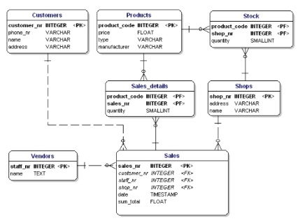

Database Management System (DBMS)
Database system
Data entry and reports
Database
Sales Department
Sales application programs
Database approach
DBMS
Data entry and reports
Contracts application programs
Contracts Department

Slide 10
Database Management System (DBMS)
DBMS: A software system that enables users to define, create, maintain, and control access to the database.
(Database) application program: a computer program that interacts with database by issuing an appropriate request (SQL statement) to the DBMS.

Slide 11
Database Approach
Controlled access to database may include:
a security system
an integrity system
a concurrency control system
a recovery control system
a user-accessible catalog.
Notes:
– a security system, which prevents unauthorized users accessing the database;
– an integrity system, which maintains the consistency of stored data;
– a concurrency control system, which allows shared access of the database;
– a recovery control system, which restores the database to a previous consistent
state following a hardware or software failure;
– a user-accessible catalog, which contains descriptions of the data in the database.

Slide 12


Data
123
Tina
CR76
Files
Application programs
File-based approach
Department X
Data
123
Tina
CR76
Files
Application programs
Department Y
Database system
Database approach
Database
X
Application programs
DBMS
Y

Slide 13
File-based vs Database
characteristics | File-based approach | Database approach
Duplication of data | Yes It costs time and money It takes additional storage space It leads to loss of data integrity | No Improved integrity and consistency of the data
Approach to data | Separation of data | Sharing of data
Concurrent access | No Access is limited to only one user at a time | Yes Provisioned shared access for multiple
Security provision | No | Yes
Recovery | Limited or nonexistent | Yes
Data dependence | Yes | No
Development time | Increased | Reduced
Productivity | Reduced | Increased

Slide 14
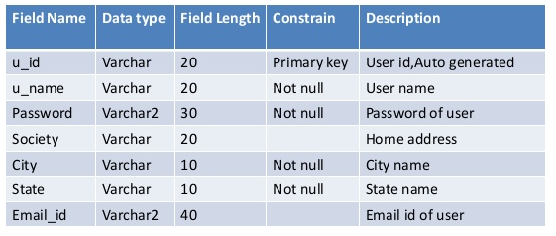


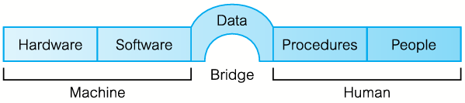






Components of DBMS Environment
ER Diagram
Data Dictionary
DB administrators
DB designers
Application developers
End-users (naive or sophisticated)
Log on to DBMS
Use DBMS’s facility
Start and stop DBMS
Make backup of the database
DBMS, operating system, application programs written in Java or C# and SQL embedded in Java or C#

Slide 15
Multi-User D B M S Architectures
The common architectures that are used to implement multi-user database management systems:
Teleprocessing
File-Server
Client-Server

Slide 16

Teleprocessing
Teleprocessing is an old architecture with one central mainframe computer and several terminals.
All the processing is performed in the mainframe computer.
User terminals are typically “dumb”, incapable of functioning on their own.
Overload the central computer
Notes:
The terminals are cabled to the central computer (mainframe).
The terminals send messages via the communications control subsystem in the OS of the central mainframe to the application program on the mainframe, which uses the services of the DMBS.
There is now a trend towards downsizing, that is, replacing expensive mainframe computers with more cost-effective networks of personal computers that achieve the same results.
This trend has given rise to the next two architectures: file-server and client-server.

Slide 17
File-server architecture
Processing
High network traffic
Retrieving corresponding files to relations (tables) instead of the records that satisfy the query
DBMSs can be different, thus, concurrency, recovery, and integrity are difficult to maintain
A computer (file-server) attached to a network with the primary purpose of providing shared storage for computer files
Storage

Slide 18
Two-tier Client-server architecture:
User interface
Business and data application logic
Consists of client process that requests resources and a server that provides resources.
Transaction logic
Database

Slide 19

Summary of Client-Server Functions
CLIENT | SERVER
Manages the user interface | Accepts and processes database requests from clients
Accepts and checks syntax of user input | Checks authorization
Processes application logic | Ensures integrity constraints not violated
Generates database requests and transmits to server | Performs query/update processing and transmits response to client
Passes response back to user | Maintains system catalog Provides concurrent database access Provides recovery control
Increased performance
Reduced communication costs
Increased consistency

Slide 20

Three-tier Client-server architecture
User interface
Designed to solve enterprise scalability challenge.
Shifting from ‘fat’ client to ‘thin’ client.
The three tiers are connected through LAN or WAN.
One application server serves multiple clients.
Business logic
Data processing logic
Thin client requires less expensive hardware
Centralized application maintenance
Modularity allows modifying or replacing one tier without affecting the others
Load balancing by separating business logic from database functions
Data validation
Database access
Notes:
The need for enterprise scalability challenged the traditional two-tier client–server model.
The Three-tier client–server architecture was designed to solve enterprise scalability challenge
In two-tiers architecture, the client side presented two problems preventing true scalability:
‘Fat’ client, requiring considerable resources on client’s computer to run effectively.
Significant client-side administration overhead which is shifted to the application server in three-tier architecture.

Slide 21
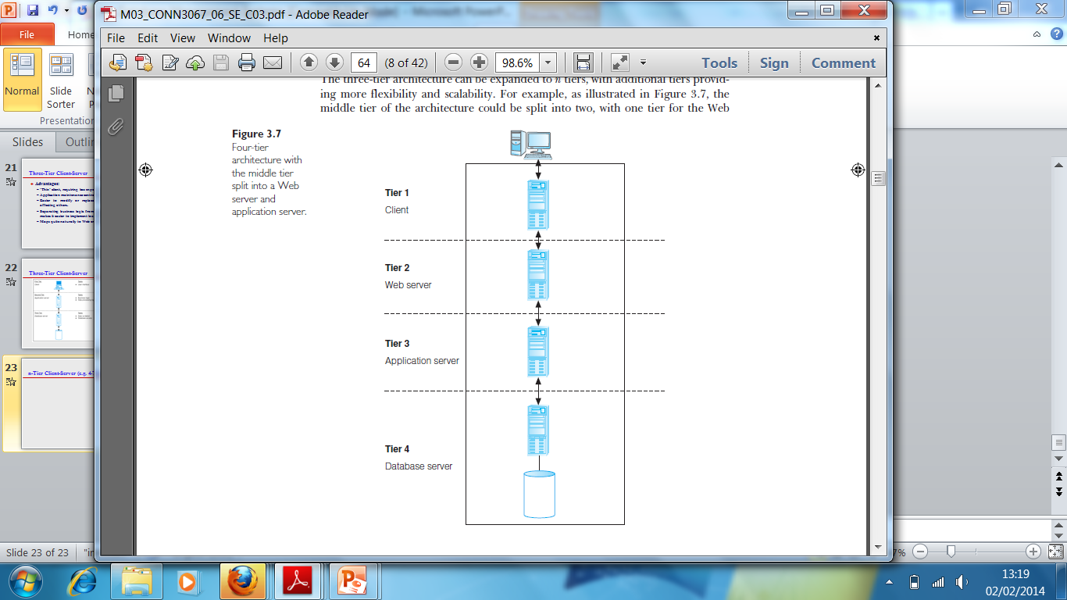
n-Tier Client-Server (e.g. 4-Tier)
The three-tier architecture can be expanded to n tiers, with additional tiers providing more flexibility and scalability.
Applications servers host A P I to expose business logic and business processes for use by other applications.

Slide 22
Cloud Computing

Slide 23
Cloud Computing
A model for enabling
Ubiquitous
Convenient
On-demand network access to a shared pool of configurable computing resources (such as networks, servers, storage, applications, and services).
These resources can be rapidly provisioned and released with minimal management effort or service provider interaction.
Defined by the National Institute of Standards and Technology (N I S T)
Notes:
Ubiquitous = allestedsnærværende

Slide 24
Cloud Computing – Key Characteristics (1 of 3)
On-demand self-service
Consumers can obtain, configure and deploy cloud services without help from provider.
Broad network access
Accessible from anywhere, from any standardized platform (e.g. desktop computers, laptops, mobile devices).

Slide 25
Cloud Computing – Key Characteristics (2 of 3)
Resource pooling
Provider’s computing resources are pooled to serve multiple consumers, with different physical and virtual resources dynamically assigned and reassigned according to consumer demand.
Examples of resources include storage, processing, memory, and network bandwidth.

Slide 26
Cloud Computing – Key Characteristics (3 of 3)
Rapid elasticity
Provider’s capacity caters for customer’s spikes in demand and reduces risk of outages and service interruptions. Capacity can be automated to scale rapidly based on demand.
Measured service
Provider uses a metering capability to measure usage of service (e.g. storage, processing, bandwidth, and active user accounts).
Notes:
Rapid elasticity: means that the capacity is increased for eksampel from 3pm-6pm when the nettwork-traffic is peaking

Slide 27
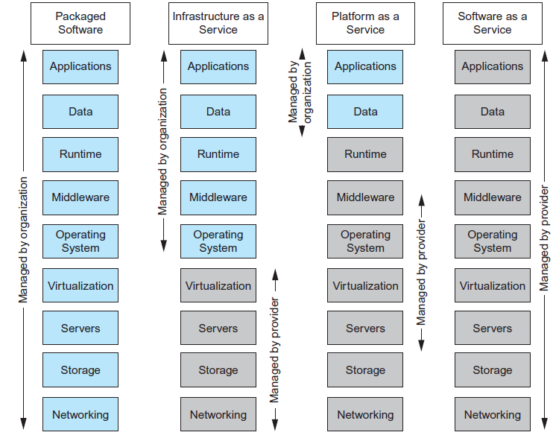
Cloud Computing –Service Models
Cloud computing service models include:
Software as a Service (SaaS)
Platform as a Service (PaaS)
Infrastructure as a Service (IaaS)
Notes:
Grey color : Cloud Service Provider Responsibility
Blue Color: Functionality assured by the customer/organization.

Slide 28
Cloud Computing Benefits and Risks
Benefits | Risks
Cost reduction Scalability/agility Improved security Access to new technologies Large-scale prototyping More flexible working practices Increased competitiveness | Network dependency System dependency Cloud provider dependency Lack of control over the data Lack of intervenability Lack of transparency

Slide 29
Components of a D B M S

Slide 30
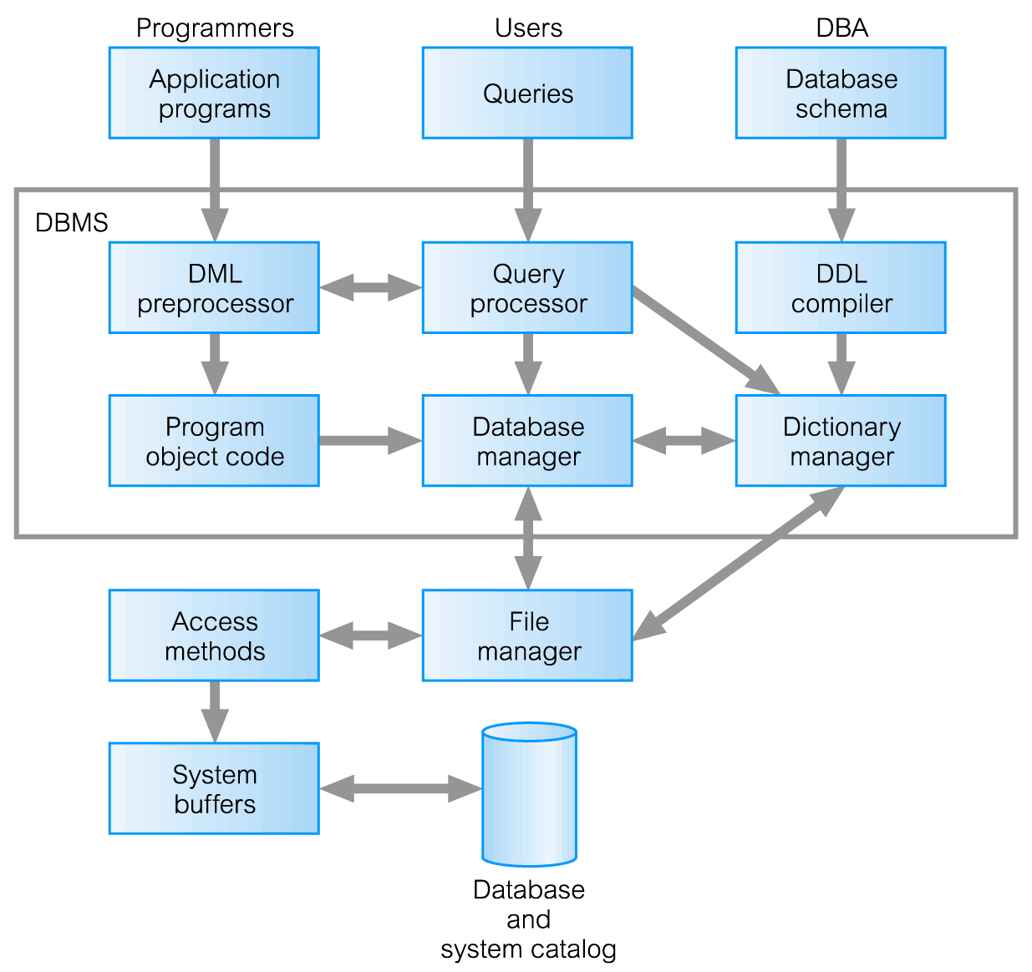
Components of a D B M S

Slide 31
Components of a D B M S
Query processor is a major DBMS component that transforms queries into a series of low-level instructions directed to the database manager.
Database manager (DM) interfaces with user-submitted application programs and queries.
The DM examines the external and conceptual schemas to determine what conceptual records are required to satisfy the request.
The DM then places a call to the file manager to perform the request.

Slide 32
Components of a D B M S
File manager manipulates the underlying storage files and manages the allocation of storage space on disk. It establishes and maintains the list of structures and indexes defined in the internal schema.
DML preprocessor converts DML statements embedded in an application program into standard function calls in the host language. The DML preprocessor must interact with the query processor to generate the appropriate code.
Dictionary/Catalog manager manages access to and maintains the system catalog. The system catalog is accessed by most DBMS components.

Slide 33
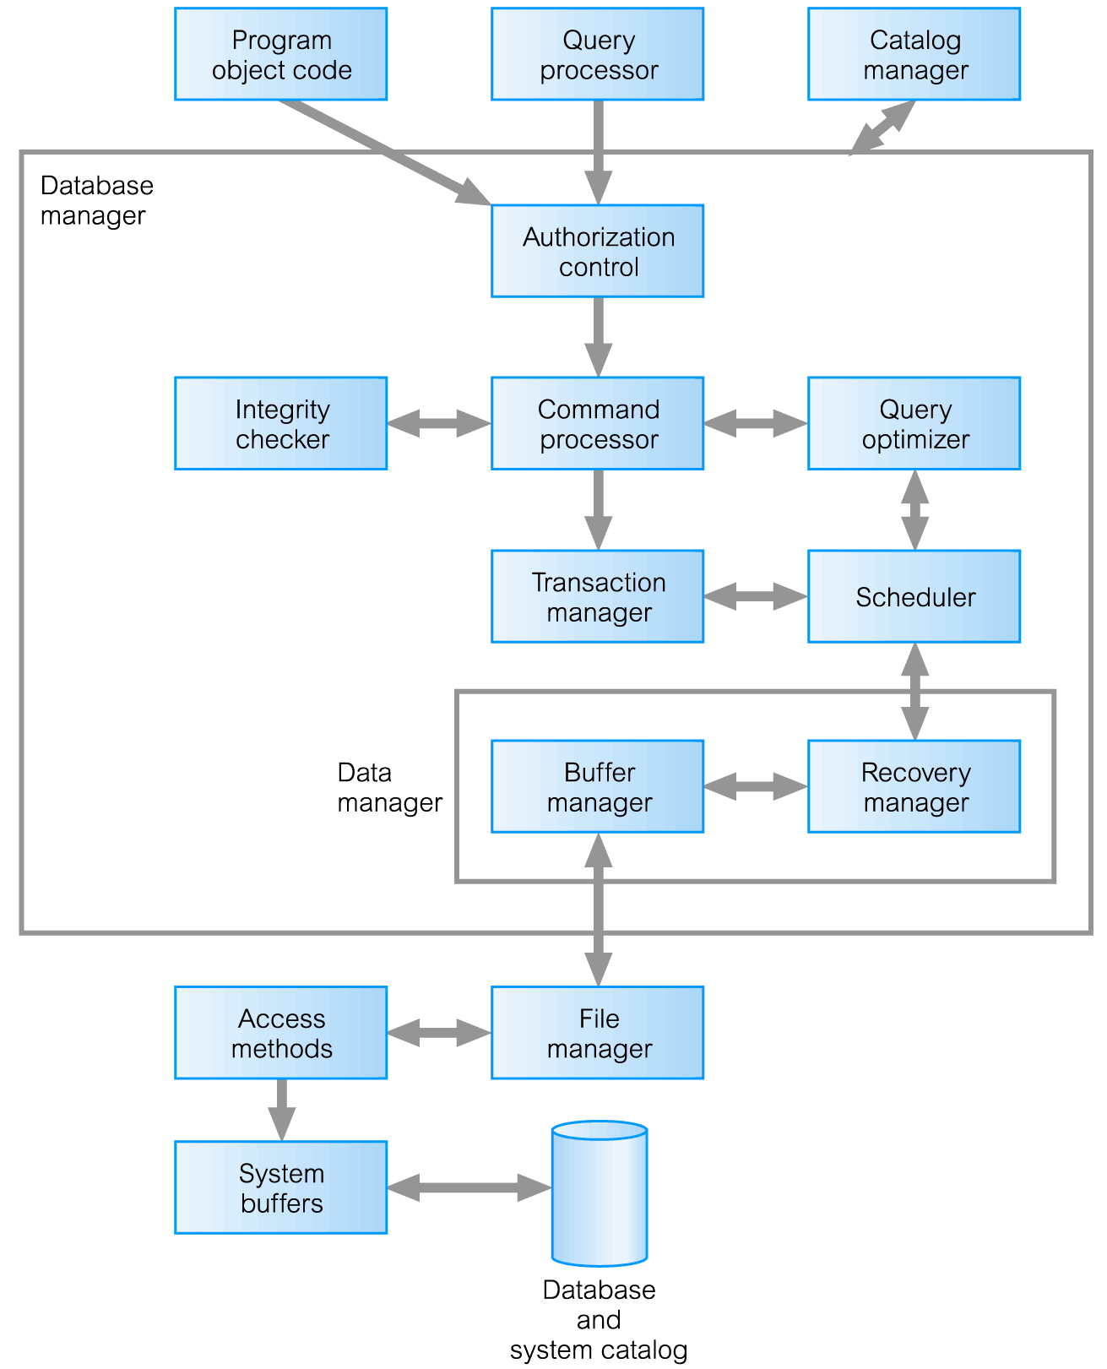
Components of Database Manager (D M) (1 of 4)

Slide 34
Components of Database Manager (DM) (2 of 4)
Authorization control to confirm whether the user has the necessary permission to carry out the required operation.
Command processor on confirmation of user authority, control is passed to the command processor.
Integrity checker ensures that requested operation satisfies all necessary integrity constraints (e.g. key constraints) for an operation that changes the database.

Slide 35
Components of Database Manager (DM) (3 of 4)
Query optimizer determines an optimal strategy for the query execution.
Transaction manager performs the required processing of operations that it receives from transactions.
Scheduler ensures that concurrent operations on the database proceed without conflicting with one another. It controls the relative order in which transaction operations are executed.

Slide 36
Components of Database Manager (DM) (4 of 4)
Recovery manager ensures that the database remains in a consistent state in the presence of failures. It is responsible for transaction commit and abort.
Buffer manager responsible for the transfer of data between main memory and secondary storage, such as disk and tape. The buffer manager also known as the cache manager.
The recovery manager and the buffer manager also known as the data manager.

Slide 37
Physical Storages and Indexes

Slide 38
Database Design Methodology
Three main phases
Conceptual database design
The process of constructing a model of the data used in an enterprise, independent of all physical considerations.
Logical database design
The process of constructing a model of the data used in an enterprise based on a specific data model, but independent of a particular DBMS and other physical considerations.
Physical database design

Slide 39
Physical Database Design
Physical Database Design: The process of producing a description of the implementation of the database on secondary storage, such as disk or tape.
Physical Database Design describes the base relations, file organizations, and indexes used to achieve efficient access to the data, and any associated integrity constraints and security measures.

Slide 40
A Brief Note On Terminology
Some important terms should be higlighted before getting into choosing file organizations and indexes
Block = Page
Unit of transfer for disk read/write. The OS (operating system) cannot read anything smaller than a block from the disk in an I/O (Input/Output) operation.
In the past a typical block size was 4KB, but today the block size is typically 64KB.
The database on secondary storage (hard disk) is organized into one or more files; each file consists of one or more records and each record consists of one or more fields
The order in which records are stored and accessed in the file is dependent on the file organization

Slide 41
A Brief Note On Terminology
The following terms will be used interchangeably. These terms have the same meaning
Entity = table = relation
Record = row = tuple
Attribute = column = field
Secondary storage called off-line storage (magnetic disks and optical disks) vs. Primary storage called online-storage (cache and main memory)
 | Example | Storage capacity | Access time | Persistence in loss of power | Cost of storage per unit
Secondary storage | Hard disk | Large | Slow | Yes (nonvolatile) | Low
Primary storage | RAM | Not large | Faster | No (volatile) | High
Notes:
Volatile: the data will be lost in a power outage

Slide 42
Disks and Files
DBMS stores information on disks.
Major implications for DBMS design!
READ: transfer data from disk to main memory (RAM).
WRITE: transfer data from RAM to disk.
Both read and write operations have a high-cost relative to memory access time because they require disk access.
The time needed to access disk is order of magnitude larger than RAM access time.

Slide 43
Components of a Disk
Spindle
Disk head
Tracks
Platters spin (say 120 rotation per second)
Surface of platter divided into circular tracks
Each track is divided into sectors
Arm assembly moved in or out to position a head on a desired track.
Tracks under heads make a cylinder (imaginary)
Cylinder i consists of i^{th} track of all the platters
Only one head reads/writes at any one time
To read/write a sector
disk arm swings to position head on right track
platter spins continually; data is read/written as sector passes under head
page size is a multiple of (fixed) sector size
Sector
Arm movement
Platters
Arm assembly

Slide 44
Accessing a Disk Page
Time to access (read/write) a disk page:
seek time (moving arms to position disk head on track)
rotational delay (waiting for page to rotate under head)
transfer time (actually moving data to/from disk surface)
Seek time and rotational delay dominate.
Seek time varies from 0 to 10msec
Rotational delay varies from 0 to 3msec
Transfer rate around .02msec per 8K page
Key to lower I/O cost: reduce seek/rotation delays! Hardware vs. software solutions?

Slide 45
Arranging Pages on Disk
`Next’ page concept:
pages on same track can be accessed quickly, followed by
pages on same cylinder, followed by
pages on adjacent cylinder
Arrange file pages sequentially on disk
minimize seek and rotational delay.
A sequential scan is an operation where we access pages that are near to each other (pages located on the same track for example).

Slide 46
Disk Space Management
The disk space management is the lowest layer of DBMS. It manages space on disk
Higher DBMS layers call upon this layer to:
allocate/de-allocate a page
read/write a page
Request for a sequence of pages are best satisfied by pages stored sequentially on disk!
Responsibility of disk space manager to allocate records to pages.
Physical details hidden from higher DBMS layers.
The disk space manager should optimally allocate record to pages to ensure a good performance of the DBMS.
Query Optimization
and Execution
Relational Operators
Files and Access Methods
Buffer Management
Disk Space Management
DB

Slide 47
File Organization

Slide 48
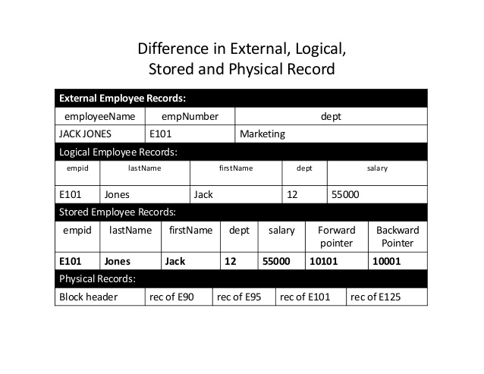
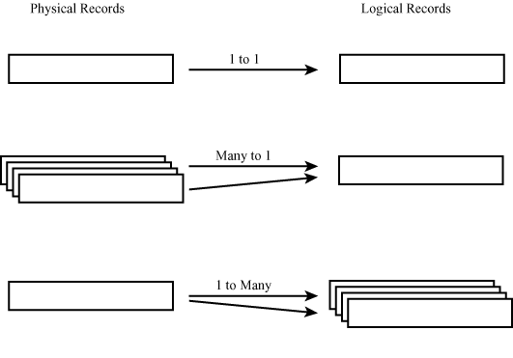
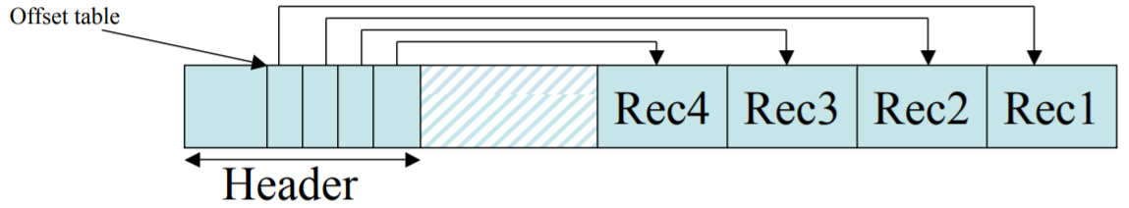
Physical record vs. Logical record
Physical record vs. Logical record
Physical record = block = page
Address of a record = address of the block that contains the record + some offset information

Slide 49
File Organization
File organization is the physical arrangement of data in a file into records and pages on secondary storage.
The main types of file organization are:
Heap (unordered) files: Records are placed on disk in no particular order.
Sequential (ordered) files: Records are ordered by the value of a specified field.
Hash files: Records are placed on disk according to a hash function.

Slide 50
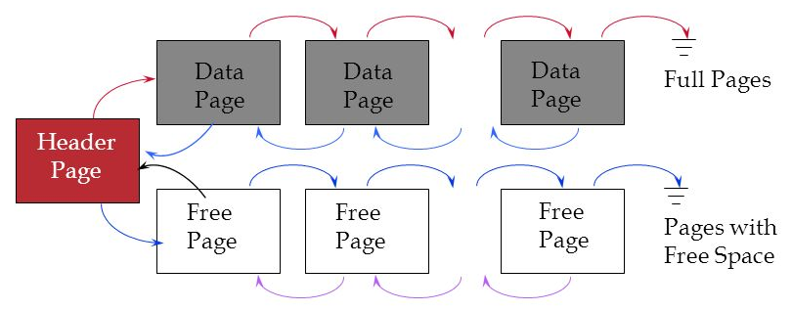
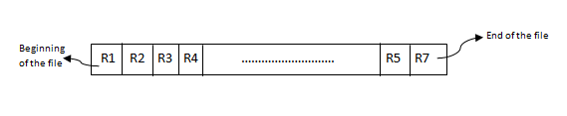
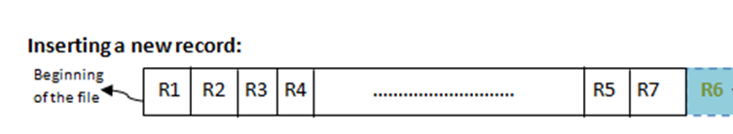
Heap Files
The simplest type of file where records are placed in the same order as they are inserted.
Insert operation: Fast and efficient for bulk loading data into a table without having to calculate what page the record should go on because a new record is inserted in the last page of the file; if there is insufficient space in the last page, a new page is added to the file.
Search operation: Slow because a linear search must be performed, which involves reading all pages from the beginning of the file until the requested record is found.
Deletion operation: Slow as linear search has to be done first to fetch the record to be deleted. After Deleting the record will create a hole in the page that cannot be re-used and it affects performance negatively. Thus, the Database Administrator (DBA) has to free this unused space of deleted records.
New record inserted R6

Slide 51
Heap File Implemented as a 2 Lists
Data
Page
Data
Page
Data
Page
Full Pages
Header
Page
Data
Page
Data
Page
Data
Page
Pages with
Free Space
The header page is pointing to 2 lists
to full pages (the gray squares): these are used if we seek to read data
free space pages (the white squares): these are used if we seek to insert data
The pointers let us walk this linked list of data pages. The pointer indicates the disk-block id of the next/previous page
Header page ID and Heap file name stored in the Database “catalog”
Each page contains 2 “pointers” plus data.

Slide 52
Sequential Files (1 of 2)
The records in a file can be sorted on the values of one or more of the fields (key-sequenced data set)
The fields that the file is sorted on is called ordering field or search-key
Delete and insert operations are problematic:
To delete a record, we must reorganize the records to remove the free slot.
To insert a new record, we must find the correct position in the ordering for the record and then find space to insert it.
If there is insufficient space in the required page or the next page, it can be a problem:
In this case, the insertion is added to the overflow file (temporary unsorted file) -> efficient for insertion, but inefficient for searching (the overflow file has to be searched linearly)

Slide 53
Sequential Files (2 of 2)
Search operations: There are two scenarios…
Tuples of the relation are ordered according to the ordering field staffNo
Tuples of the relation are ordered on staffNo under certain conditions
No sorting is needed
Binary search
Notes:
The binary search proceeds as follows:
(1) Retrieve the mid-page of the file. Check whether the required record is between the first and last records of this page. If so, the required record lies on this page and no more pages need to be retrieved.
(2) If the value of the key field in the first record on the page is greater than the required value; the required value, if it exists, occurs on an earlier page. Therefore, we repeat the previous steps using the lower half of the file as the
new search area.
(3) If the value of the key field in the last record on the page is less than the required value, the required value occurs on a later page, and so we repeat the previous steps using the top half of the file as the new search area. In this way,
half the search space is eliminated from the search with each page retrieved.

Slide 54
Hash Files (1 of 2)
Records are not written sequentially to the file.
Instead, a hash function calculates the address of the page in which the record to be stored based on one or more fields in the record
The base field is called a hash field and if it is also the key field of the file, it is called a hash key
Records in a hash file appear randomly distributed across the available file space (thus, hash files are sometimes called random files).
Each address generated by a hashing function corresponds to a page or bucket with slots for multiple records
Hash functions do not guarantee generating a unique address causing a problem of collision

Slide 55
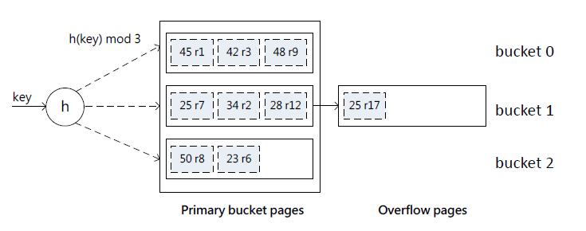
Hash Files (2 of 2)
Designed for equality selection
Uses a hashing function
Search values → bucket numbers
Bucket
Primary page plus zero or move overflow pages
Based on static or dynamic hashing techniques
Notes:
This is an example

Slide 56
Indexing

Slide 57
What is an index?
A data structure that allows the DBMS to locate particular records in a file more quickly and thereby speed response to queries.
An index in a database is similar to an index in a book.
It is an auxiliary structure associated with a file that can be referred to when searching for an item of information, just like searching the index of a book, in which we look up a keyword to get a list of one or more pages on which the keyword appears.
An index removes the need to scan sequentially through the file each time we want to find the item.
https://www.youtube.com/watch?v=Le74ewlajxg
https://www.youtube.com/watch?v=fsG1XaZEa78
Notes:
Auxiliary structure: tilleggsstruktør

Slide 58
Basic Concepts
Indexing mechanisms used to speed up access to desired data.
E.g., author catalog in library
Search Key - attribute to set of attributes used to look up records in a file.
An index file consists of records (called index entries) of the form
Index files are typically much smaller than the original file
Search keys are stored in sorted order
search-key
pointer

Slide 59
Index Definition in SQL
Create an index
create index <index-name> on <relation-name> (<attribute-list>)
E.g.,: create index b-index on branch(branch_name)
Use create unique index to indirectly specify and enforce the condition that the search key is a candidate key.
To drop an index
drop index <index-name>
Most database systems allow specification of type of index, and clustering.

Slide 60
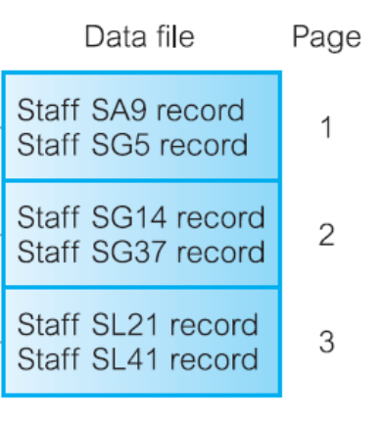
Select Index
Query
SELECT * FROM students WHERE dept = 10;
Index: a data structure (file) defined on fields that speeds up data accessing
Ordering key value
(SA9 is the staff_id)
Address of the record
Search key

Slide 61
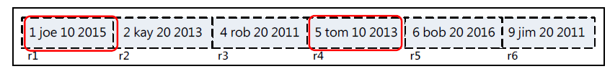
Why Index?
Query
SELECT * FROM students WHERE dept = 10;
Record file for students
Selectivity is usually low
Full table scan results in poor performance

Slide 62
Dense and Sparse Indexes
Indexes can be dense (index for every search key value) or sparse (index for some search key values)
Dense index
Sparse index

Slide 63
Types of Index
Primary index: The data file is sequentially ordered by an ordering key field (a Primary key), and the indexing field is built on the ordering key field, which is guaranteed to have a unique value in each record.
Clustering index: The data file is sequentially ordered on a non-key field, and the indexing field is built on this non-key field, so that there can be more than one record corresponding to a value of the indexing field. The non-key field is called a clustering attribute.
Secondary index: An index that is defined on a non-ordering field of the data file.
A file can have at most one primary index or one clustering index.
In addition, a file can have several secondary indexes.
An index can be sparse or dense.

Slide 64
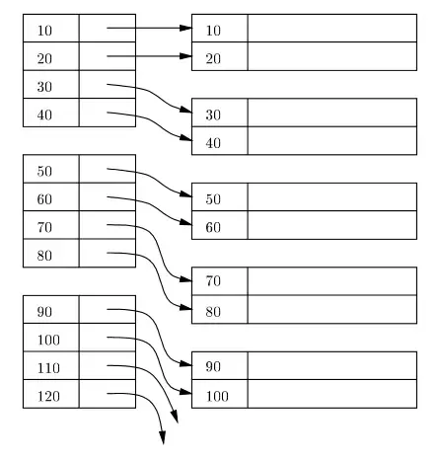
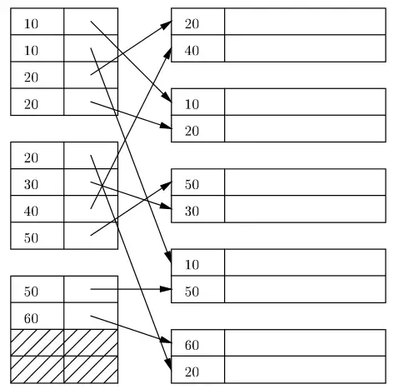
Main types of indexes
Primary index: data file and the indexing field are ordered by the ordering key field
Secondary index: the index is defined on a non-ordering field of the data file
Indexed sequential file
Notes:
If ordering attribute chosen is key of relation, index will be a primary index; otherwise, index will be a clustering index.
Each relation can only have either a primary index or a clustering index.
Secondary indexes provide a mechanism for specifying an additional key for a base relation that can be used to retrieve data more efficiently.

Slide 65
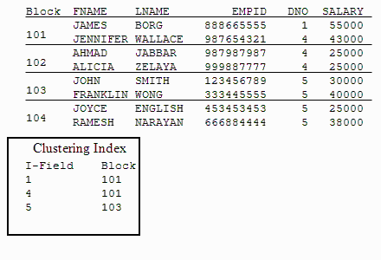
Clustering Indexes
With clustering index, the data file is sequentially ordered by a non-key field and the indexing field is built on this non-key field (e.g., department number)
There can be more than one record corresponding to a value of the indexing key (that is a non-key)
Non-key (clustering attribute)

Slide 66
Is Hash-Based Index Good Enough?
Hash-based indexes are good for equality selections
However, Hash-based indexes cannot support range searches
E.g,…… WHERE dept > 100;
We now consider an index structured as a search tree
Speeds up search by sorting values
Supports both range and equality searches

Slide 67
B+ tree
Most widely used index
Particular type of multilevel dense index that many DBMS use.
It is a hierarchy of nodes with a depth that must balanced (that every path from root to leaf must have the same length), each node is actually a page
Its order or degree is determined by the maximum number of children allowed per parent

Slide 68
Example of B⁺-Tree

Slide 69
B⁺-Tree Index Files
Disadvantage of indexed-sequential files (in indexes search keys are stored in sorted order. Therefore, we can save them in sequential files.)
Performance degrades as file grows.
Periodic reorganization of entire file is required.
Advantage of B⁺-tree index files:
Automatically reorganizes itself with small, local, changes, in the face of insertions and deletions.
Reorganization of entire file is not required to maintain performance.
(Minor) disadvantage of B⁺-trees:
Extra insertion and deletion overhead, space overhead.
Advantages of B⁺-trees outweigh disadvantages
B⁺-trees are used extensively

Slide 70
B⁺-Tree

Slide 71

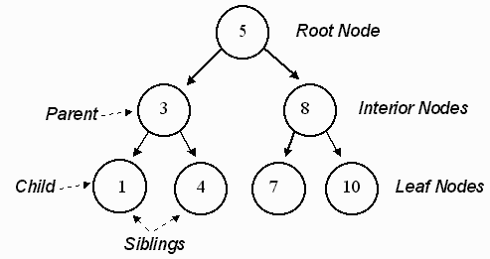
Tree in Computer Science
Root
Leaf

Slide 72
Balanced Tree Vs. Unbalanced Tree
Search the value 18 in the following tree
It takes 5 hops to find that 18 is not in this unbalanced tree (low efficiency)
1
5
6
7
10

Slide 73
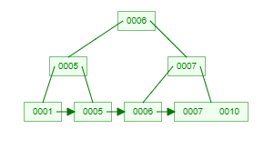
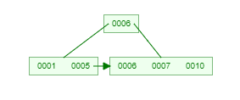
Balanced Tree Vs. Unbalanced Tree
Search the value 18 in the following tree
It takes 3 hops to find that 18 is not in a tree of order 3
It takes 2 hops to find that 18 is not in a tree of order 5

Slide 74
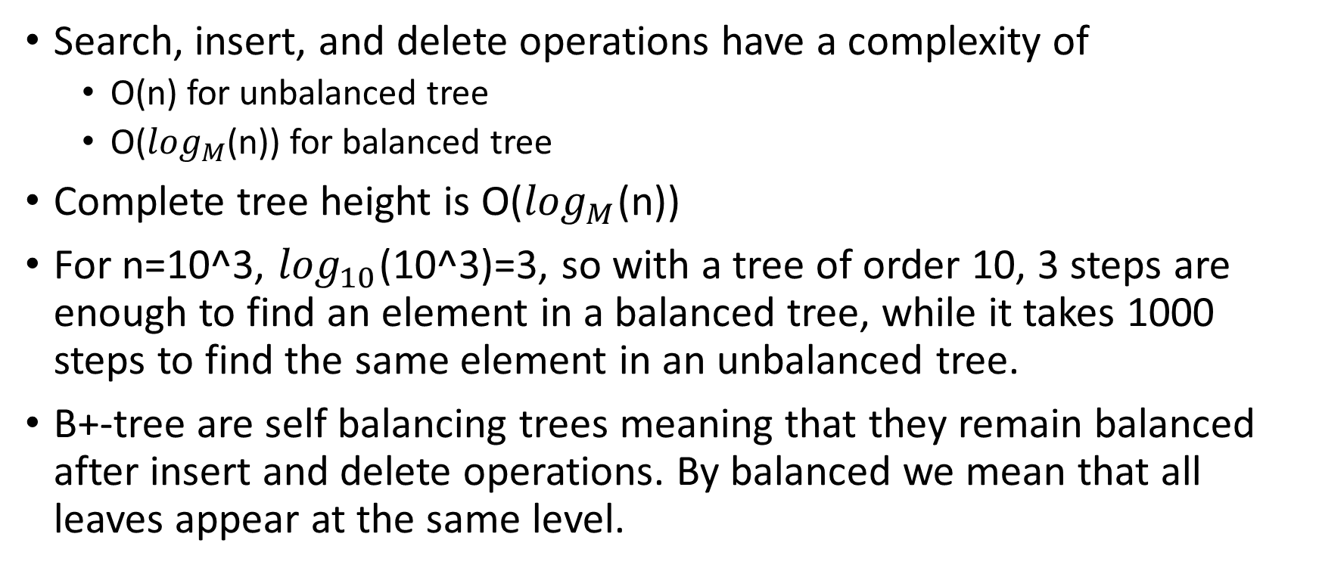
Balanced Tree Vs. Unbalanced Tree
Search, insert, and delete operations have a complexity of
O(n) for unbalanced tree
O($\log_{M}$(n)) for balanced tree
Complete tree height is O($\log_{M}$(n))
For n=10^3, $\log_{10}$(10^3)=3, so with a tree of order 10, 3 steps are enough to find an element in a balanced tree, while it takes 1000 steps to find the same element in an unbalanced tree.
B+-tree are self balancing trees meaning that they remain balanced after insert and delete operations. By balanced we mean that all leaves appear at the same level.

Slide 75
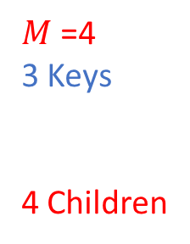
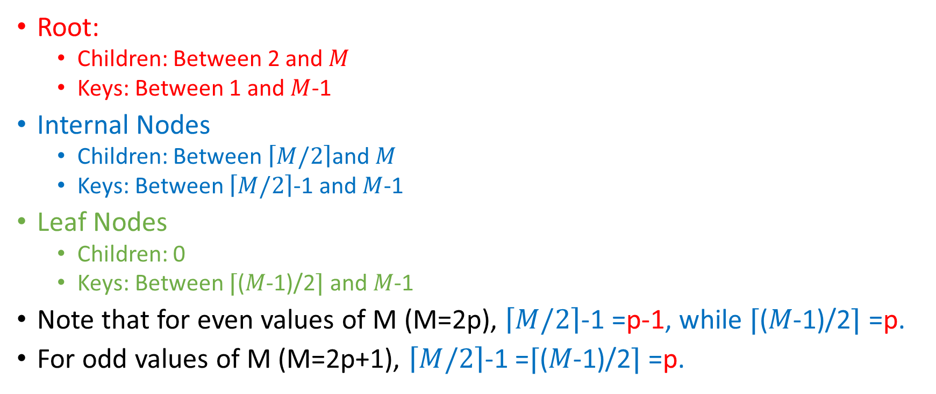
B+ Tree Structure Properties
$M$=4
3 Keys
4 Children
Root:
Children: Between 2 and $M$
Keys: Between 1 and $M$-1
Internal Nodes
Children: Between $\left\lceil M/2\right\rceil$and $M$
Keys: Between $\left\lceil M/2\right\rceil$-1 and $M$-1
Leaf Nodes
Children: 0
Keys: Between ⌈(𝑀-1)/2⌉ and 𝑀-1
Note that for even values of M (M=2p), $\left\lceil M/2\right\rceil$-1 =p-1, while ⌈(𝑀-1)/2⌉ =p.
For odd values of M (M=2p+1), $\left\lceil M/2\right\rceil$-1 =⌈(𝑀-1)/2⌉ =p.
K1
K2
K3
Ch1
Ch2
Ch3
Ch4

Slide 76
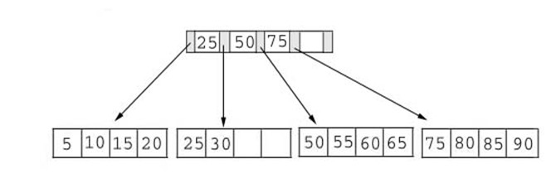
Simple structure of B+ tree
Route values are used to guide the search in the tree
(Non leaf node): contains route values that are the same as key values
(Leaf nodes): contain the actual key values: the data.
The data is stored in the leaf nodes.

Slide 77
Insertion Algorithm
We will focus only on insertion algorithms for B+-Tree.
Deletion will not be discussed.
For Insertion we need to concentrate only on the maximum number of keys which is M-1 for the root, internal nodes, and leaf nodes.
For a tree of order M=5, the maximum number of keys per node is M-1=5-1=4.

Slide 78
Animation: Insert 8*
8*
Root
13
17
24
30
2*
3*
5*
7*
14*
19*
20*
22*
24*
27*
29*
33*
34*
38*
39*
14
16*
5
Traverse to leaf
Split Leaf
Copy up middle key
Split Parent
New Root
Push up middle key

Slide 79
Final B+ Tree - Inserting 8*
Root
Root
17
13
17
24
30
5
13
24
30
2*
3*
5*
7*
8*
14*
16*
19*
20*
22*
24*
27*
29*
33*
34*
38*
39*
2*
3*
5*
7*
14*
16*
19*
20*
22*
24*
27*
29*
33*
34*
38*
39*
Notice that root was split, leading to increase in height.
Notes:
13

Slide 80
Data vs. Index Page Split (from previous example of inserting “8*”)
Data Page Split
2*
3*
5*
7*
8*
Observe how minimum occupancy is guaranteed in both leaf and index pg splits.
Note difference between copy-up and push-up; be sure you understand the reasons for this.
Entry to be inserted in parent node.
…
5
(Note that 5 is
s copied up and
continues to appear in the leaf.)
2*
3*
5*
7*
8*
Index Page Split
30
5
13
17
24
Entry to be inserted in parent node.
17
(Note that 17 is pushed up and only
appears once in the index. Contrast
this with a leaf split.)
5
13
24
30
Notes:
12

Slide 81
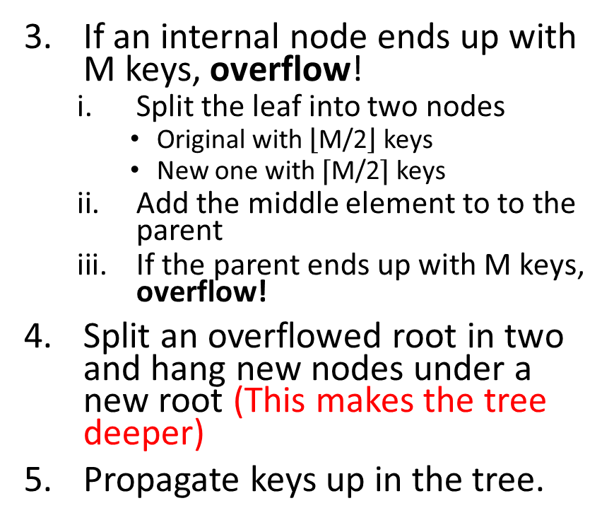
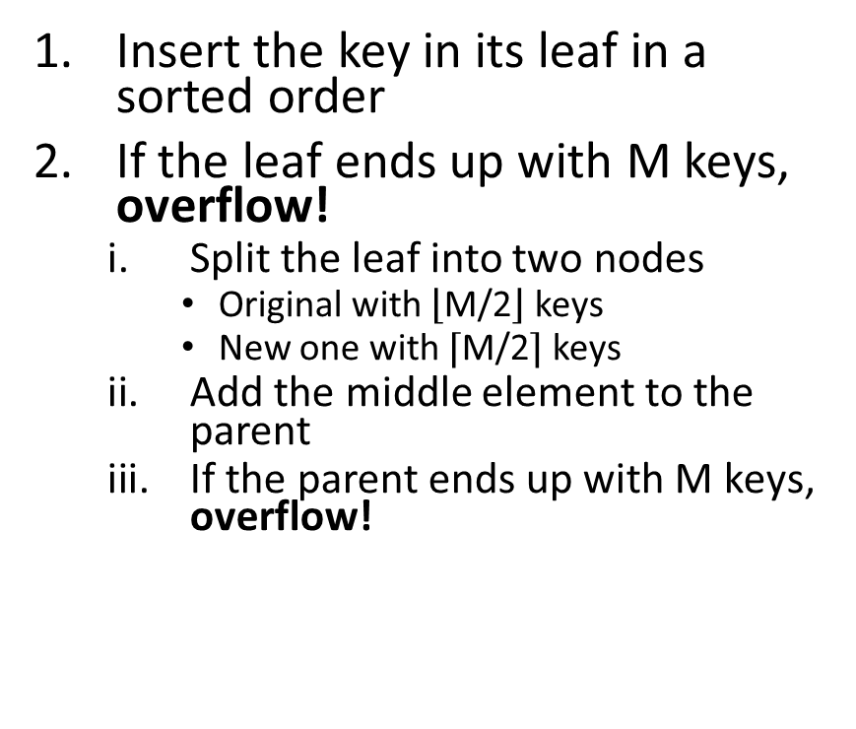
Insertion Algorithm
Insert the key in its leaf in a sorted order
If the leaf ends up with M keys, overflow!
Split the leaf into two nodes
Original with $\left\lfloor \text{M}\text{/2}\right\rfloor$ keys
New one with ⌈M/2⌉ keys
Add the middle element to the parent
If the parent ends up with M keys, overflow!
If an internal node ends up with M keys, overflow!
Split the leaf into two nodes
Original with $\left\lfloor \text{M}\text{/2}\right\rfloor$ keys
New one with ⌈M/2⌉ keys
Add the middle element to to the parent
If the parent ends up with M keys, overflow!
Split an overflowed root in two and hang new nodes under a new root (This makes the tree deeper)
Propagate keys up in the tree.

Slide 82
Exercise
Create a tree of order 3 and insert the elements 1,5,6 in the tree and draw the resulting tree.
Now insert 7 and draw the updated tree.
Now insert 10 and draw the resulting tree.
For a tree of order M=3, the maximum number of keys per node is M-1=2.

Slide 83
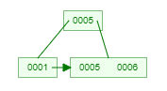
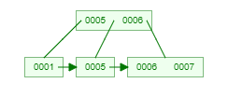
Exercise Solution
The maximum number of keys per node is 2.
Create a tree of order 3 and insert the elements 1,5,6 in the tree and draw the resulting tree.
Now insert 7 and draw the updated tree.
Now insert 10 and draw the resulting tree.

Slide 84
Nice Animation On-Line
https://www.cs.usfca.edu/~galles/visualization/BPlusTree.html

Slide 85
DB Security

Slide 86
Database Security
Data is a valuable resource that must be strictly controlled and managed, as with any corporate resource.
Part or all of the corporate data may have strategic importance and therefore needs to be kept secure and confidential.

Slide 87
Database Security
The mechanisms that protect the database against unauthorized access, either intentional or accidental
Encompasses hardware, software, people, and data
Aims to minimize losses caused by anticipated events in a cost effective manner
Requires appropriate controls defined in the mission objectives of the system

Slide 88
Three Main Objectives
Secrecy: Information should not be disclosed to unauthorized users.
Example: a student should not be allowed to examine other students' grades.
Integrity: Only authorized users should be allowed to modify data.
For example: students may be allowed to see their grades, but not allowed (obviously) to modify them.
Availability: Authorized users should not be denied access.
For example: an instructor who wishes to change a grade should be allowed to do so.

Slide 89
Database Security
Database security involves measures to avoid:
Theft and fraud
Loss of confidentiality (secrecy)
Loss of privacy
Loss of integrity
Loss of availability

Slide 90
Examples of Common Breach Situations and Their Impacts
Fraud or loss of privacy may not result in changes to the database
Theft and fraud affect the database environment and the entire organization, and may not alter the data, but may result in loss of confidentiality or loss of privacy
Confidentiality is concerned with maintaining secrecy of critical data to the organization (loss of confidentiality results in loss of competitiveness)
Privacy is concerned with protecting data about individuals (loss of privacy results in a legal action being taken against the organization)
Loss of integrity results in invalid or corrupted data and can seriously affect the operations of an organization
Loss of availability results in the data, or the system, or both cannot be accessed, and may affect seriously the organization’s financial performance or cause data corruption

Slide 91
Database Security
Threat
Any situation or event, whether intentional or unintentional, that will adversely affect a system and consequently an organization.
Tangible harm (loss of hardware, software, or data)
Intangible harm (loss of credibility or client confidence)

Slide 92
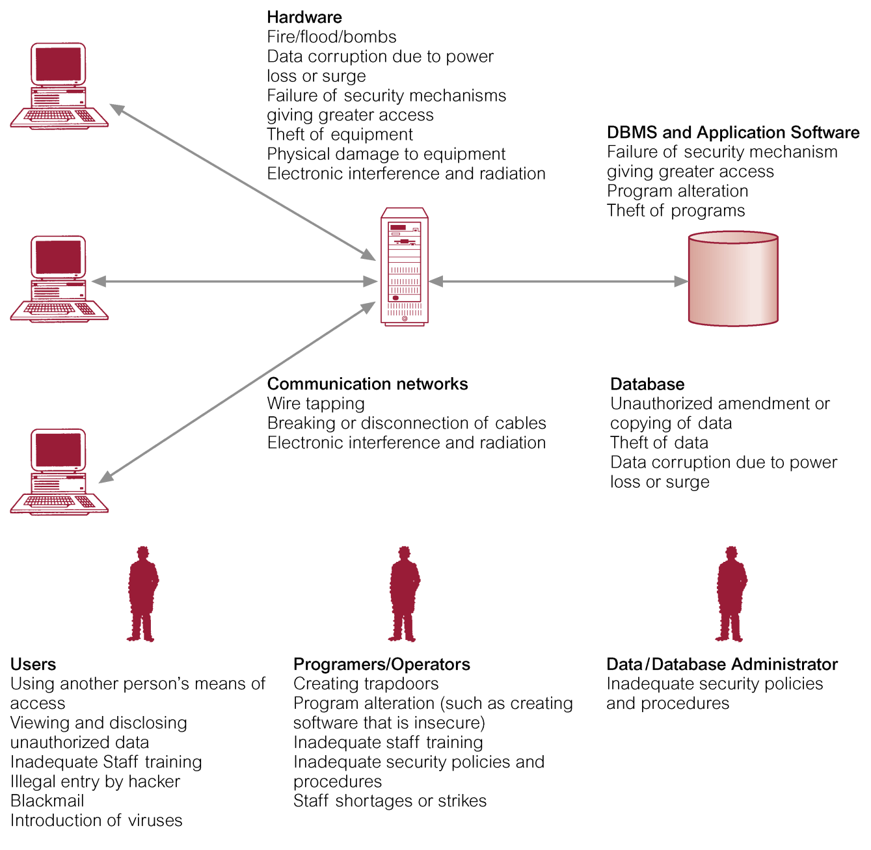
Summary of Threats to Computer Systems

Slide 94
Countermeasures – Computer-Based Controls (1 of 8)
Concerned with physical controls to administrative procedures and includes:
Authorization
Access controls
Views
Backup and recovery
Integrity
Encryption

Slide 95
Countermeasures – Computer-Based Controls (2 of 8)
Authorization
The granting of a right or privilege, which enables a subject to legitimately have access to a system or a system’s object (such as a relation, view, and index).
Authorization is a mechanism that determines whether a user is, who he or she claims to be.

Slide 96
Countermeasures – Computer-Based Controls (3 of 8)
Access control
Based on the granting and revoking of privileges.
A privilege allows a user to create or access (that is read, write, or modify) some database object (such as a relation, view, and index) or to run certain D B M S utilities.
Privileges are granted to users to accomplish the tasks required for their jobs.

Slide 97
Countermeasures – Computer-Based Controls (4 of 8)
Most D B M S provide an approach called Discretionary Access Control (D A C).
S Q L standard supports D A C through the GRANT and REVOKE commands.
The GRANT command gives privileges to users, and the REVOKE command takes away privileges.
Structure of GRANT statement:
GRANT <list of privileges e.g., SELECT, INSERT, UPDATE, DELETE>
ON <relation or another object (view for example)>
TO <list of authorization IDs>
WITH GRANT OPTION; → The user granted the privilege can grant that privilege to other users
Structure of REVOKE statement:
REVOKE <list of privileges>
ON <relation or another object>
FROM <list of authorization IDs>
CASCADE/RESTRICT; → the grant given by the revokee is not in force anymore

Slide 98
Example GRANT - REVOKE
Joe is the creator of Sailors table
GRANT SELECT ON Sailors TO Alice WITH GRANT OPTION (executed by Joe)
GRANT SELECT ON Sailors TO Bob WITH GRANT OPTION (executed by Alice)
REVOKE SELECT ON Sailors FROM Alice CASCADE (executed by Joe)
Since the privilege is revoked from Alice with cascade. The privilege is automatically revoked from Bob, because Bob got its privilege from Alice (This is the impact of the keyword cascade).

Slide 99
Authorization
We may assign a user several forms of authorizations on parts of the database.
Read - allows reading, but not modification of data.
Insert - allows insertion of new data, but not modification of existing data.
Update - allows modification, but not deletion of data.
Delete - allows deletion of data.
Each of these types of authorizations is called a privilege. We may authorize the user all, none, or a combination of these types of privileges on specified parts of a database, such as a relation or a view.

Slide 100
Authorization Specification in SQL
The grant statement is used to confer authorization
grant <privilege list> on <relation or view > to <user list>
<user list> is:
a user-id
public, which allows all valid users the privilege granted
A role (more on this later)
Example:
grant select on department to Roger, Rafa
Granting a privilege on a view does not imply granting any privileges on the underlying relations.
The grantor of the privilege must already hold the privilege on the specified item (or be the database administrator).

Slide 101
Privileges in SQL
select: allows read access to relation, or the ability to query using the view
Example: grant users U₁, U₂, and U₃ select authorization on the instructor relation (table):
grant select on instructor to U₁, U₂, U₃
insert: the ability to insert tuples
update: the ability to update using the SQL update statement
delete: the ability to delete tuples.
all privileges: used as a short form for all the allowable privileges

Slide 102
Revoking Authorization in SQL
The revoke statement is used to revoke authorization.
revoke <privilege list> on <relation or view> from <user list>
Example:
revoke select on student from U₁, U₂, U₃
<privilege-list> may be all to revoke all privileges the revokee may hold.
If <revokee-list> includes public, all users lose the privilege except those granted it explicitly.
If the same privilege was granted twice to the same user by different grantees, the user may retain the privilege after the revocation.

Slide 103
Countermeasures – Computer-Based Controls (5 of 8)
D A C while effective has certain weaknesses. In particular an unauthorized user can trick an authorized user into disclosing sensitive data.
An additional approach is required called Mandatory Access Control (MAC).

Slide 104
Mandatory Access Control
MAC is applied through a popular model called Bell-LaPadula, according to Bell-LaPadula model:
Each database object is assigned a security class, there are four classes:
Top Secret (TS),
Secret (S),
Confidential (C),
Unclassified (U).
These classes are ordered as TS > S > C > U, where data of class TS has a higher security level than S class data.

Slide 105
Mandatory Access Control
Each subject is assigned a clearance for a security class regarding the read and write restrictions on database object.
Read restrictions: subject S can read object O only if class (S) >= class (O) →
a user with clearance TS can read an object with TS, S, C, and U classes
but a user with C clearance cannot read an object with S, TS classes.
Write restrictions: S can write O only if class (S) <= class (O) → a user with clearance S can only write objects with S and TS classes.

Slide 106
Popular Model for MAC called Bell-LaPudula
MAC policies do apply to relations and also to records! Assume that each record is assigned a security level, this is called a multilevel relation
Example: Given the following multilevel relation, what records can be read by users with TS, S, C, and U clearances?
client No | f Name | l Name | tel No | pref Type | max Rent | security Class
C R76 | John | Kay | 0207-774-5632 | Flat | 425 | C
C R56 | Aline | Stewart | 0141-848-1825 | Flat | 350 | C
C R74 | Mike | Ritchie | 01475-392178 | House | 750 | S
C R62 | Mary | Tregar | 01224-196720 | Flat | 600 | S
Now, assume that a user with clearance C wishes to enter a tuple (CR74, David, Sinclaire) into the Client relation, What do you think would happen?!
Notes:
This insertion is disallowed, because it violates the primary key constraint (primary key cannot be the same for two records) for this relation.
However, the inability to insert this new tuple informs the user with clearance C that a tuple exists with a primary key value of CR74 at a higher security class than C.
This compromises the security requirement that users should not be able to infer any information about objects that have a higher security classification.
This situation explain the write restriction rules in the previous slide

Slide 107
Popular Model for MAC called Bell-LaPudula
Adding the record violates the primary key constraints and the existing record has a higher security class (S), but:
By considering the securityClass as part of the primary key clientNo, the new record can be added to the relation! → this is called polyinstantiation
The presence of data objects that appear to have different values to users with different clearances
client No | F Name | L Name | Tel No | prefType | Max Rent | securityClass
C R76 | John | Kay | 0207-774-5632 | Flat | 425 | C
C R56 | Aline | Stewart | 0141-848-1825 | Flat | 350 | C
C R74 | Mike | Ritchie | 01475-392178 | House | 750 | S
C R62 | Mary | Tregar | 01224-196720 | Flat | 600 | S
C R74 | David | Sinclaire | Blank | Blank | Blank | C
Now, what records can be read by users with TS, S, C, and U clearances?
Notes:
This situation may be dealt with by assuming that the tuple with the higher classification takes priority over the other.

Slide 108
Countermeasures – Computer-Based Controls (6 of 8)
View
A view is a virtual relation that does not actually exist in the database, but is produced upon request by a particular user, at the time of request.
A view is defined based on one or more tables which are known as base tables.
When you create a view, you basically create a query and assign a name to the query. Therefore, a view is useful for wrapping a commonly used complex query.
A view helps simplify the complexity of a query because you can query a view, which is based on a complex query, using a simple SELECT statement.
Notice that a view does not store data physically except for a materialized view.
Create a view
CREATE VIEW YoungSailors (sic, age, rating)
AS SELECT S.sid, S.age, S.rating
FROM Sailors S
WHERE age < 18;
Query a view
SELECT * FROM YoungSailors;

Slide 109
Countermeasures – Computer-Based Controls (7 of 8)
Backup
Process of periodically taking a copy of the database and log file (and possibly programs) to offline storage media.
Journaling
Process of keeping and maintaining a log file (or journal) of all changes made to database to enable effective recovery in event of failure.

Slide 110
Countermeasures – Computer-Based Controls (8 of 8)
Integrity
Prevents data from becoming invalid, and hence giving misleading or incorrect results.
Encryption
The encoding of the data by a special algorithm that renders the data unreadable by any program without the decryption key.

Slide 111
Encryption
Encryption transforms data into cipher text readable only by sender and receiver
Encryption secures stored information and information transmission
Encryption provides 3 key dimensions of security:
Message integrity: ensures that the information was not modified
Authentication: The identity of the sender and receiver can be determined
Confidentiality: No one other than the intended receiver can read your message
Two main categories of cryptography systems
Symmetric key cryptography
Public key cryptography

Slide 112
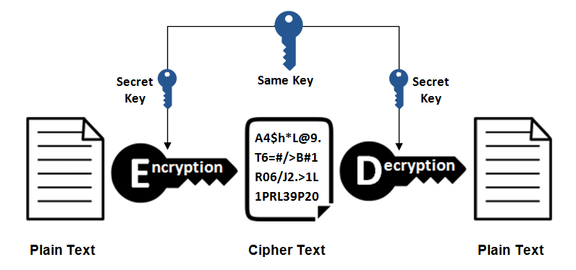
Symmetric Key Cryptography
Sender and receiver use same digital key to encrypt and to decrypt message
Requires different set of keys for each transaction
The strength of the encryption depends on the length of the binary key.
Example of symmetric key encryption algorithms
Data Encryption Standard (DES): developed by the National Security Agency (NSA) and IBM in the 1950s. DES uses a 56-bit encryption key.
Advanced Encryption Standard (AES): the most widely used symmetric key algorithm is AES, which offers key sizes of 128, 192, and 256 bits.
Symmetric Encryption

Slide 113
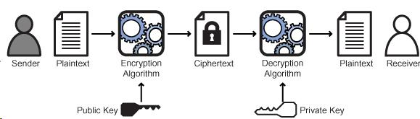
Public Key Cryptography
Is a cryptographic system that uses pairs of keys. (Public key of A, Private key of A)
Each pair consists of a public key (is widely distributed and known to others) and a private key (kept secret by owner).
Sender encrypt the message with public key of the receiver; then the receiver decrypt the message with his private key.
Note that when the sender S sends a message to A, it uses the public key of A. Whereas, when S sends a message to B, it uses the public key of B.
A message sent to A (encrypted with the public key of A) can only be decrypted by A because the decryption requires the use of the private key of A. This private key is only known to A.
Public key Encryption

Slide 114
Access controls
-Discretionary Access Control (DAC)
-Mandatory Access Control (MAC)
-Multilevel relations and polyinstantiation
-Views
-Backup and recovery
-Integrity
-Encryption
Authorization and authentication
DBMS
Subject
-Users
-Programs
Object
-Relations
-Views
-Tuples
-Attributes
-Keeps track of how privileges are granted/revoked to users
-Provides GRANT and REVOKE commands to DBAs
-Provides encryption facility
-Determines whether a given user can read or write on a given object based on rules of security level of the object (security classes) and the security clearance of the user
GRANT? REVOKE?
Security classes? Clearance?

Slide 115
Store Procedures

